Slide 1
Math 769: Statistical Learning

Slide 2
Bootstrapping
Shahrzad Jamshidi, PhD

Slide 3
Last Time
We explored k-fold cross validation, which was a technique we can use when our dataset is too small to allow for a testing set.
We discussed how to use this method to estimate the expected prediction error as well as some considerations for picking the number of folds.

Slide 4
Objectives
Define Bootstrapping.
Explain how bootstrapping can construct an estimator for the model.
Construct the estimator for the expected prediction error.
Define the 0.632 estimator.

Slide 5
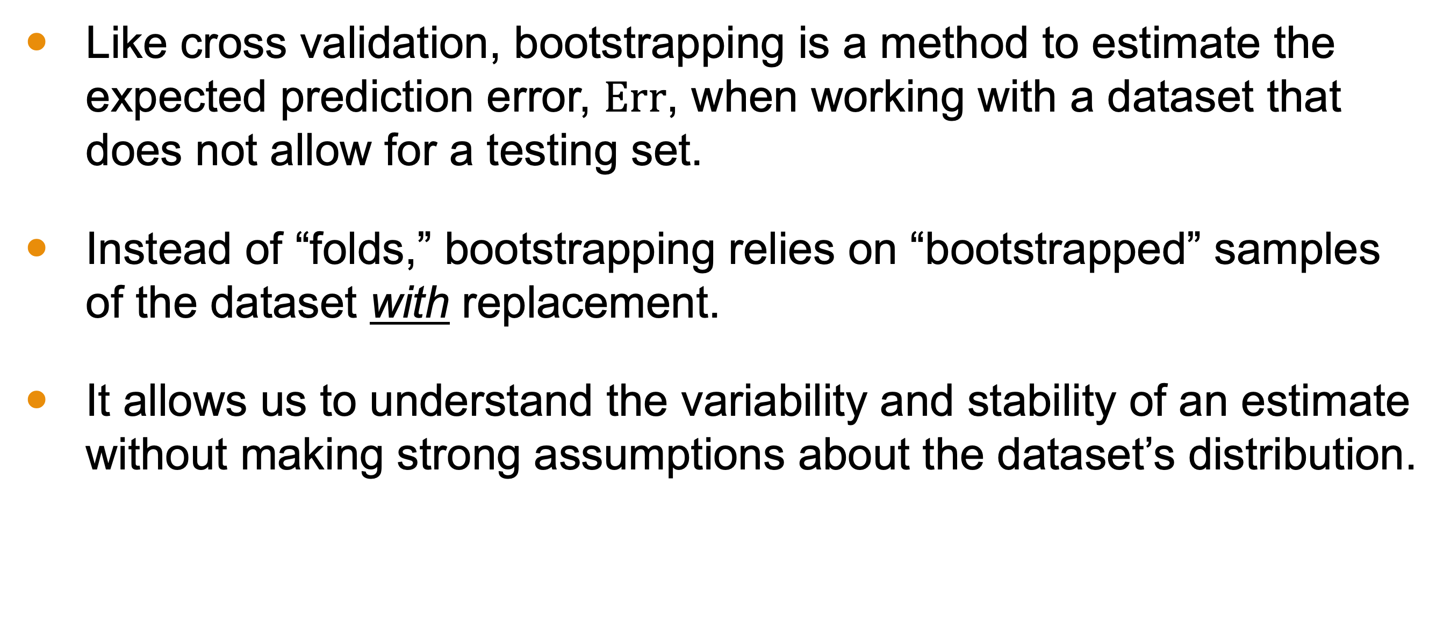
Purpose of Bootstrapping
Like cross validation, bootstrapping is a method to estimate the expected prediction error, $\text{Err}$, when working with a dataset that does not allow for a testing set.
Instead of “folds,” bootstrapping relies on “bootstrapped” samples of the dataset with replacement.
It allows us to understand the variability and stability of an estimate without making strong assumptions about the dataset’s distribution.

Slide 6
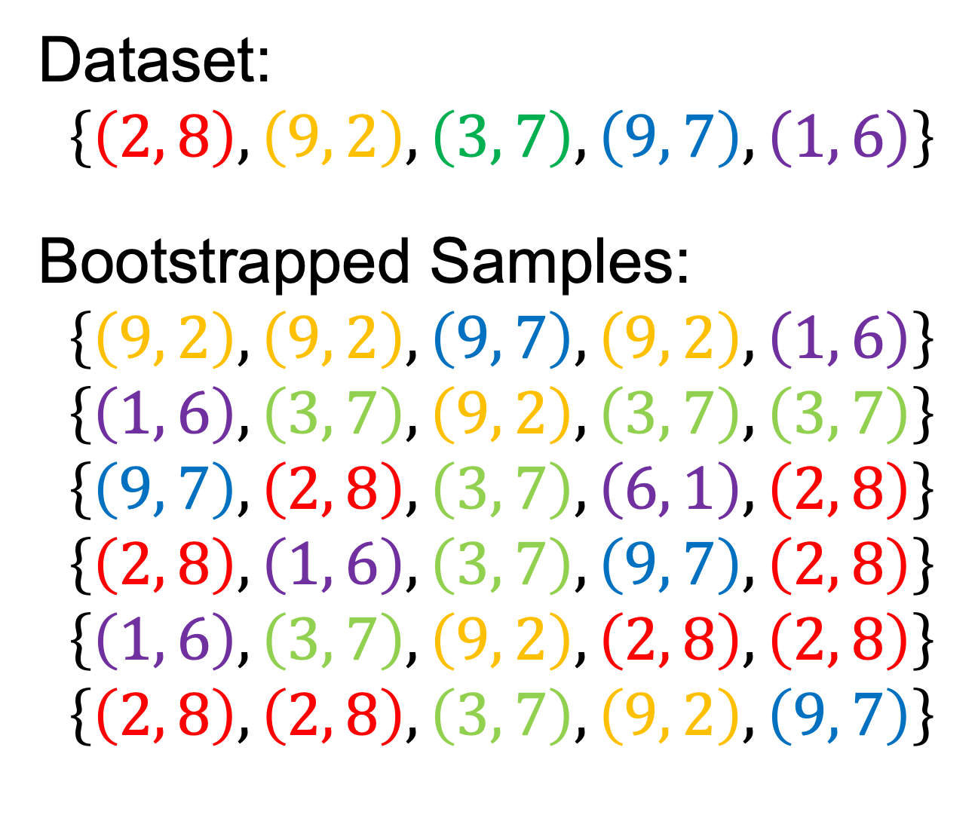
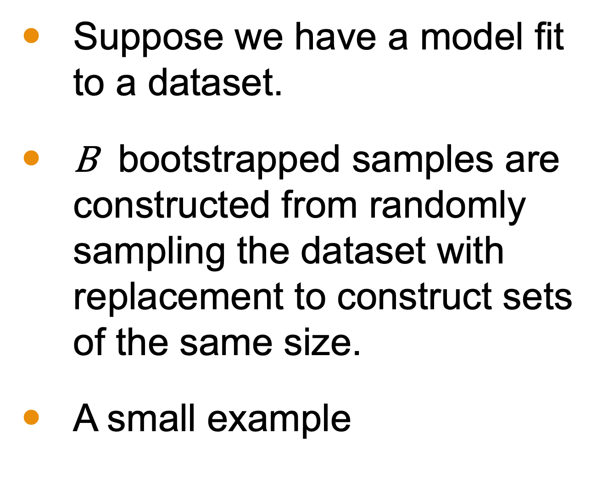
Bootstrapped Samples
Suppose we have a model fit to a dataset.
$\text{B}$ bootstrapped samples are constructed from randomly sampling the dataset with replacement to construct sets of the same size.
A small example
Dataset:
$$\left\{\left(2, 8\right), \left(9, 2\right), \left(3, 7\right), \left(9, 7\right), \left(1, 6\right)\right\}$$
Bootstrapped Samples:
$$\left\{\left(9, 2\right),\left(9, 2\right),\left(9, 7\right), \left(9, 2\right), \left(1, 6\right)\right\}$$
$$\left\{\left(1, 6\right),\left(3, 7\right),\left(9, 2\right),\left(3, 7\right),\left(3, 7\right)\right\}$$
$$\left\{\left(9, 7\right),\left(2, 8\right),\left(3, 7\right),\left(6, 1\right),\left(2, 8\right)\right\}$$
$$\left\{\left(2, 8\right),\left(1, 6\right),\left(3, 7\right),\left(9, 7\right),\left(2, 8\right)\right\}$$
$$\left\{\left(1, 6\right),\left(3, 7\right),\left(9, 2\right),\left(2, 8\right),\left(2, 8\right)\right\}$$
$$\left\{\left(2, 8\right),\left(2, 8\right),\left(3, 7\right),\left(9, 2\right),\left(9, 7\right)\right\}$$

Slide 7
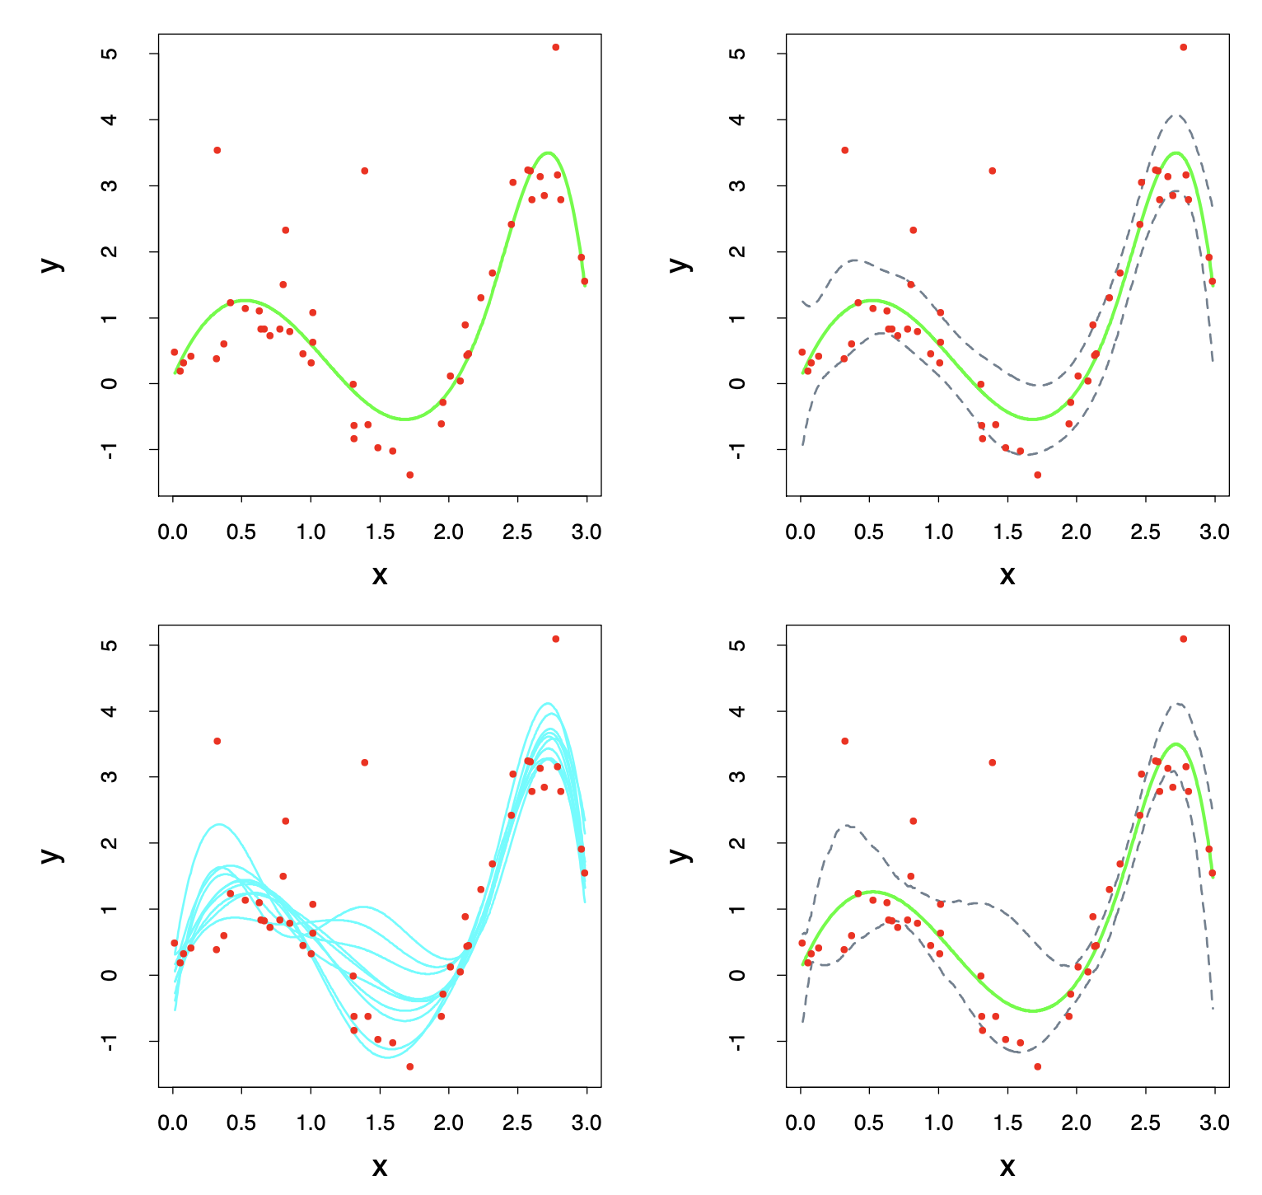
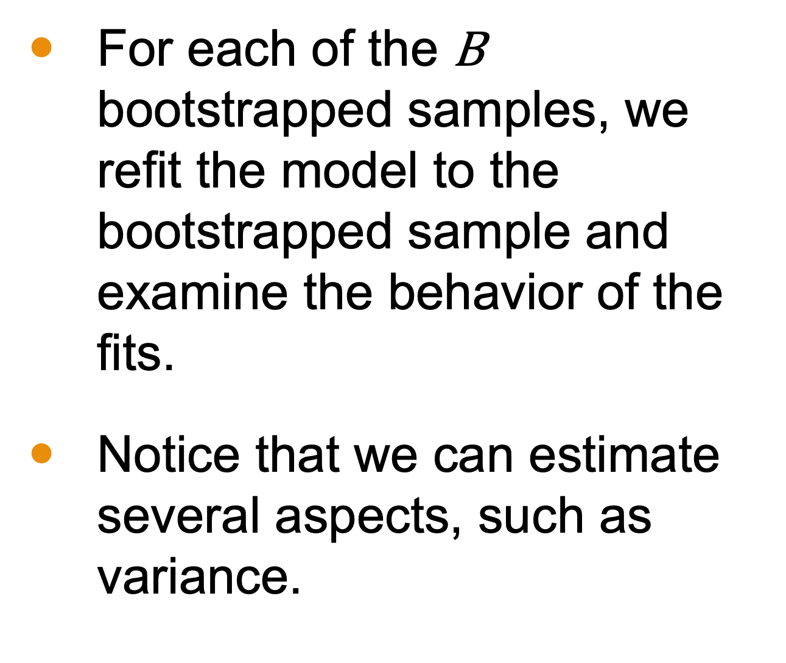
Using the Bootstrapped Samples
For each of the $\text{B}$ bootstrapped samples, we refit the model to the bootstrapped sample and examine the behavior of the fits.
Notice that we can estimate several aspects, such as variance.

Slide 8
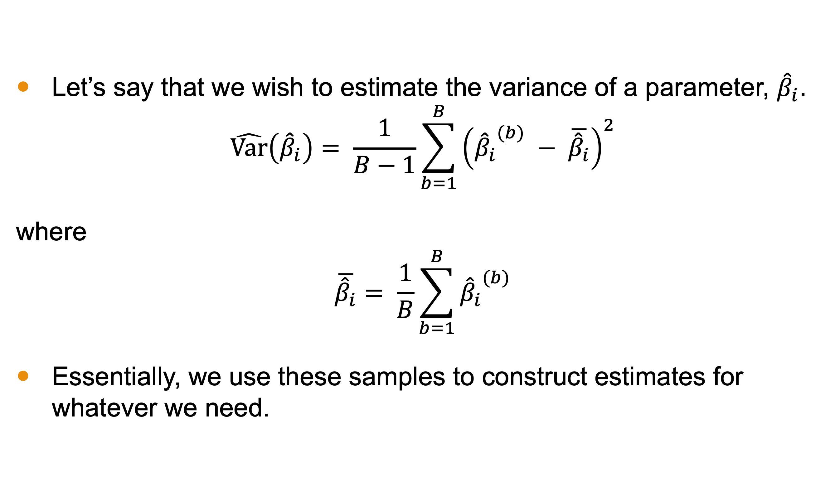
Example: Estimating Parameter Variance
Let’s say that we wish to estimate the variance of a parameter, ${\hat{β}}_{i}$.
$$\hat{Var}\left({\hat{β}}_{i}\right)= \frac{1}{B−1}\sum_{b=1}^{B}{{\left({{\hat{β}}_{i}}^{(b)} − \overline{{\hat{β}}_{i}}\right)}^{2}}$$
where
$$\overline{{\hat{β}}_{i}}= \frac{1}{B}\sum_{b=1}^{B}{{{\hat{β}}_{i}}^{(b)}}$$
Essentially, we use these samples to construct estimates for whatever we need.

Slide 9
This technique can be thought of as a Monte-Carlo estimate under sampling from an empirical distribution.

Slide 10
Estimating Expected Prediction Error
The process for estimating the expected prediction error involves looking at the average loss of a hold-out set from the bootstrapped one.
Here are two ways to set this up.
Do a training-test split of each bootstrapped sample, construct the model on the training portion and measure the loss on the testing portion. Take the average of the losses to estimate the error.
We compute the loss for each point on only models trained on samples without the point.

Slide 11
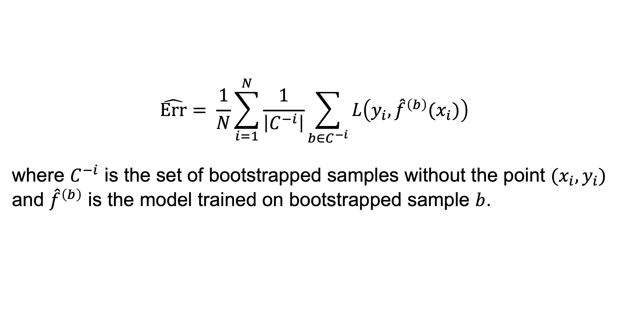
Estimating Expected Prediction Error
$$\hat{Err}= \frac{1}{N}\sum_{i=1}^{N}{\frac{1}{\left|C^{−i}\right|}\sum_{b∈C^{−i}}{L\left(y_{i},{\hat{f}}^{\left(b\right)}(x_{i})\right)}}$$
where $C^{−i}$ is the set of bootstrapped samples without the point ${(x}_{i},y_{i})$ and ${\hat{f}}^{\left(b\right)}$ is the model trained on bootstrapped sample $b$.

Slide 12
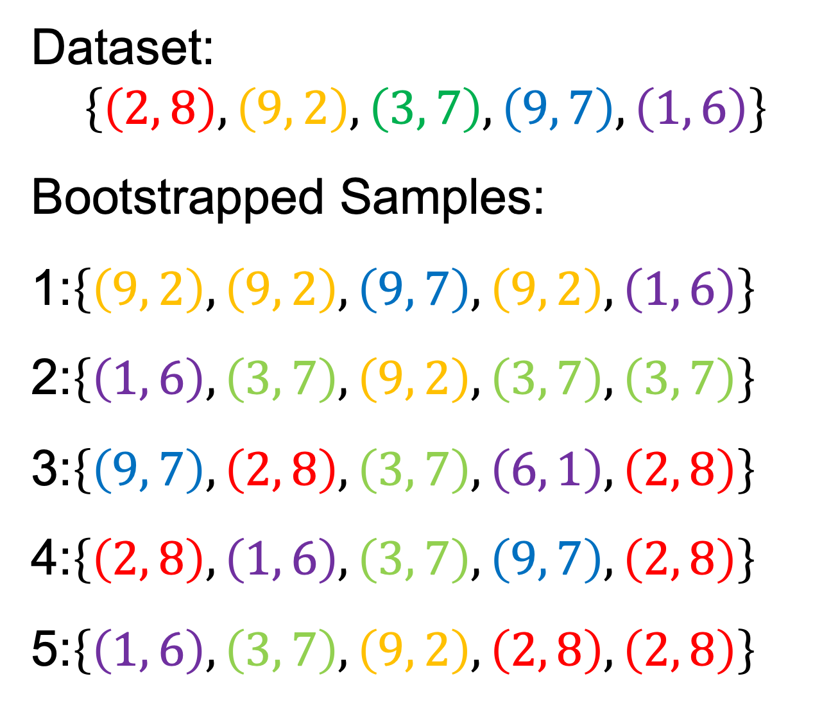
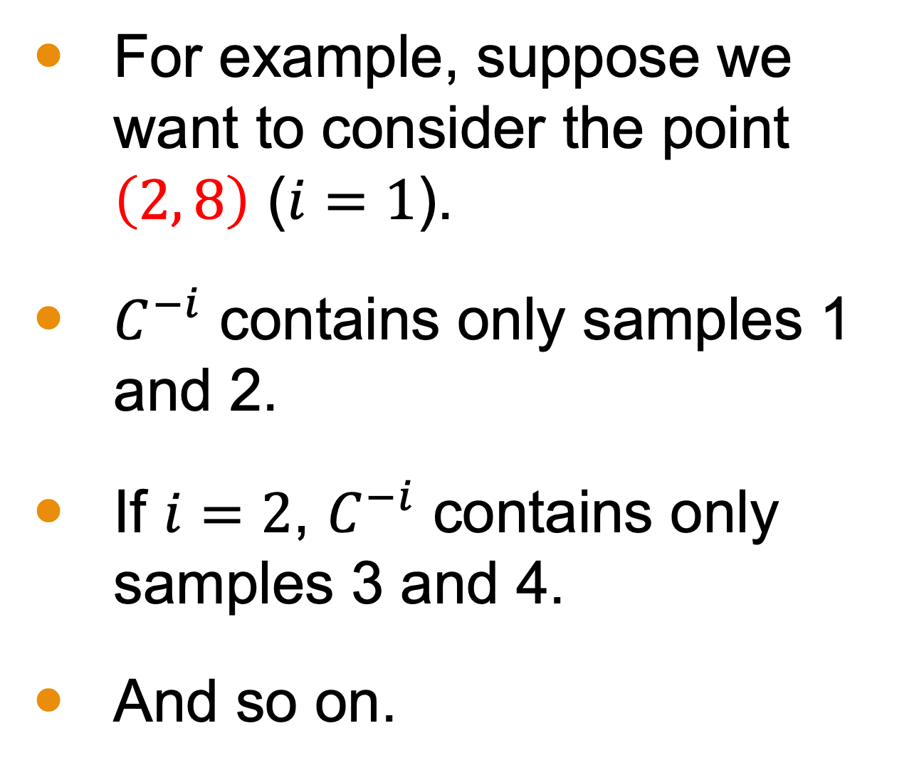
Estimating Expected Prediction Error
For example, suppose we want to consider the point $\left(2, 8\right)$ ($i=1$).
$C^{−i}$ contains only samples 1 and 2.
If $i=2$, $C^{−i}$ contains only samples 3 and 4.
And so on.
Dataset:
$$\left\{\left(2, 8\right), \left(9, 2\right), \left(3, 7\right), \left(9, 7\right), \left(1, 6\right)\right\}$$
Bootstrapped Samples:
1:$\left\{\left(9, 2\right),\left(9, 2\right),\left(9, 7\right), \left(9, 2\right), \left(1, 6\right)\right\}$
2:$\left\{\left(1, 6\right),\left(3, 7\right),\left(9, 2\right),\left(3, 7\right),\left(3, 7\right)\right\}$
3:$\left\{\left(9, 7\right),\left(2, 8\right),\left(3, 7\right),\left(6, 1\right),\left(2, 8\right)\right\}$
4:$\left\{\left(2, 8\right),\left(1, 6\right),\left(3, 7\right),\left(9, 7\right),\left(2, 8\right)\right\}$
5:$\left\{\left(1, 6\right),\left(3, 7\right),\left(9, 2\right),\left(2, 8\right),\left(2, 8\right)\right\}$

Slide 13
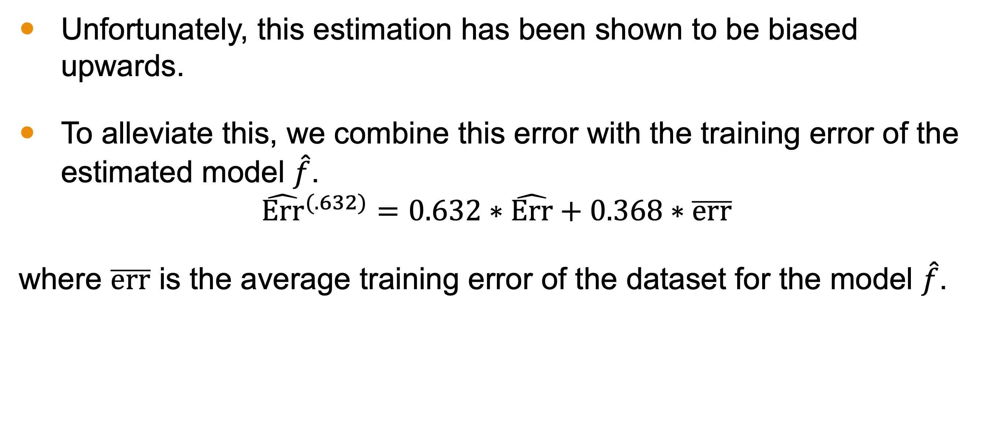
0.632 Estimator
Unfortunately, this estimation has been shown to be biased upwards.
To alleviate this, we combine this error with the training error of the estimated model $\hat{f}$.
$${\hat{Err}}^{(.632)}=0.632∗\hat{Err}+0.368∗\overline{err}$$
where $\overline{err}$ is the average training error of the dataset for the model $\hat{f}$.

Slide 14
Conclusion
Bootstrapping is a technique where one samples the dataset with replacement to constructed Monte-Carlo-type estimates for almost anything related to the model.
This is ideal for datasets too small to allow for a testing set.
The expected prediction error can be estimated; however, it has been shown to have bias.
We often use the “0.632 estimator” to better EPE estimate.

